Slide 1

Petabyte Pirates

Slide 2

Desired Goal(s)
Interests included:
Housing market trends
Predicting failure of Infrastructure
Diagnostics for Healthcare
Diagnostics for Machine Maintenance
And a few more…
Decided on:
Predict the sale price of a house going up for sale

Slide 3
Selecting the Dataset
We examined the available datasets on
Kaggle
Data.gov
FiveThirtyEight
Zillo
Redfin
Chose
Ames Iowa Housing Sales from Kaggle
https://www.kaggle.com/datasets/shashanknecrothapa/ames-housing-dataset

Slide 4
Dataset Characteristics
Number of Instances: 2,930
Number of Features: 79
Data types include both numerical and categorical values
Record of home sales from January 2006 to July 2010

Slide 5
Discovery

Slide 6
Features

Slide 7
Analysis

Slide 8



Architecture
Front End Web Server
Back End Web Server
Web Application
ML Engine
Port 80/443
Rest API
Ames Iowa Home Sales
Port 5000

Slide 9
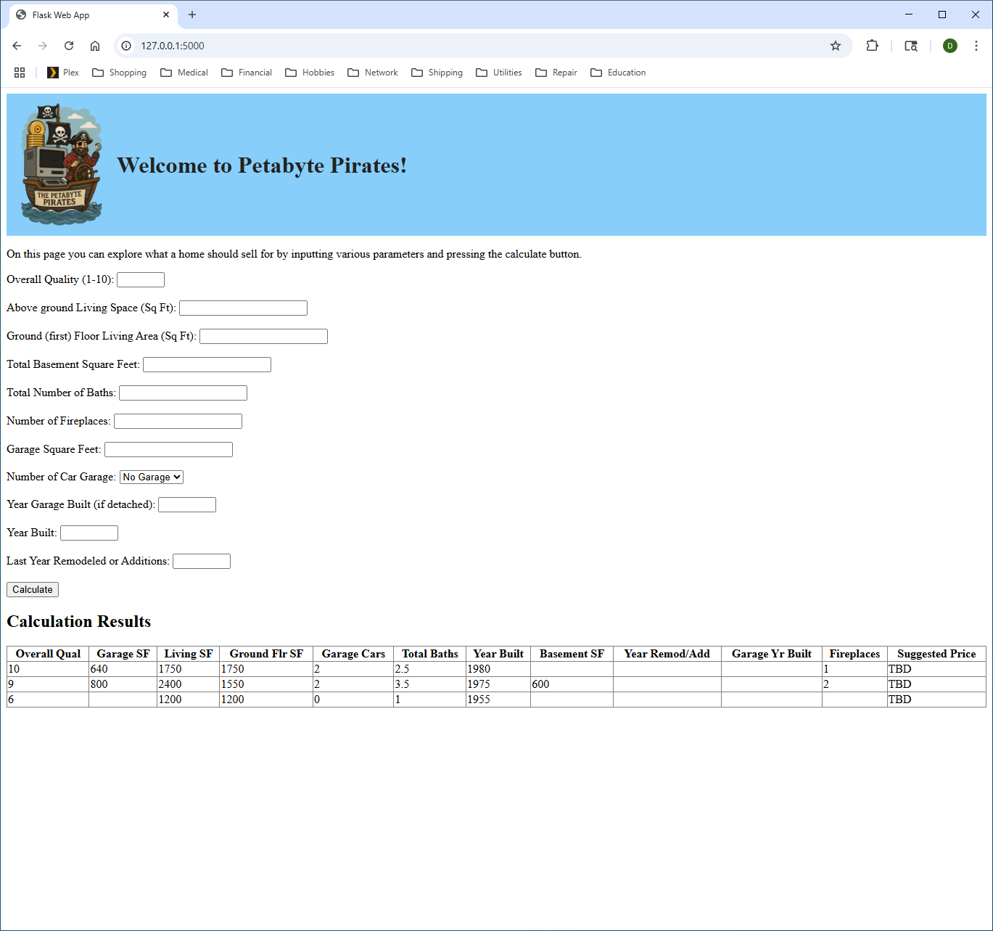
Presentation
Form for user to input parameters to predict price of home. The result of each request is saved as a table below, allowing “what-if” comparisons.
Each result of the input calculation is saved in a table. All columns of the table are sortable. This allows the user to perform what-if comparisons and to compare multiple properties.

